Slide 1
nat5 GRAPHIC COMMUNICATION
Sectioning

Slide 2
Learning intentions & success criteria
Learning Intentions
Gain an understanding of sectional views, their purpose and benefits.
Success Criteria
Interpret a sectional drawing and state the identifying features.
Explain the conventions for sectional drawings.

Slide 3
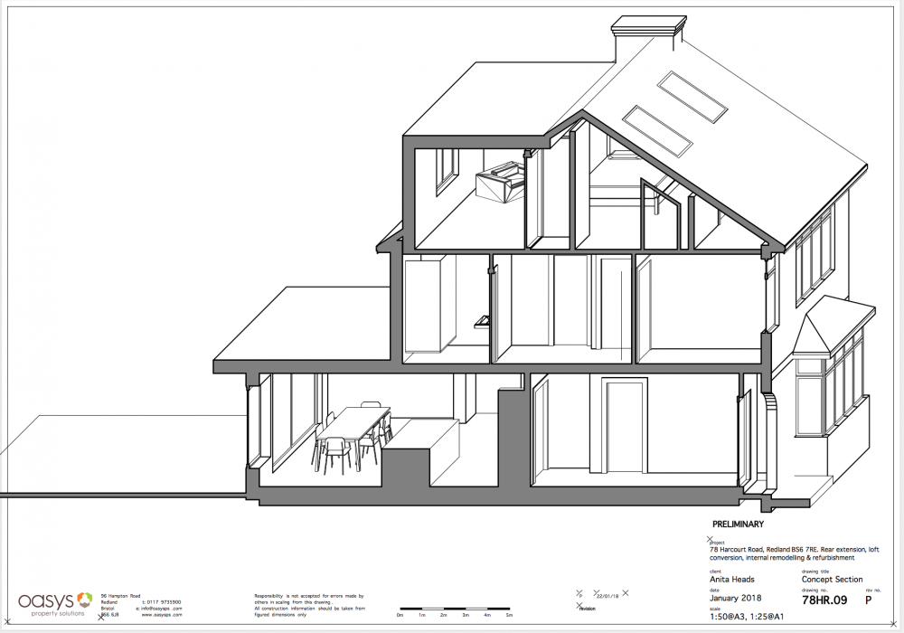
introduction
A section view is a view used on a drawing to show an area or hidden part of an object by cutting away or removing some of that object.
Sectional views are useful in architecture, product design or generally anything that has important details inside that are useful to see.

Slide 4
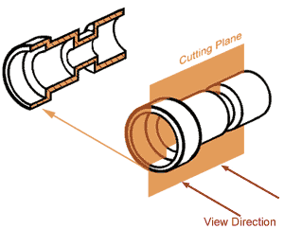
Cutting plane
The cut line is called a “cutting plane”, and can be done in several ways.

Slide 5
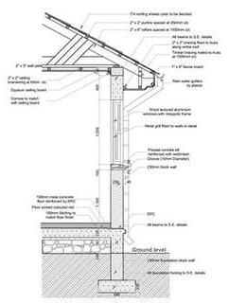
Why produce Sectional views?
A sectional view shows what is left of the object after the imaginary slice has been removed.
The diagram below shows a sectional view, and how a cutting plane works.
Sectional views are produced to:
Clarify drawings
Show internal features clearly
Reduce the number of hidden lines required.
Aid dimensioning
Show cross section shape
Clarify an assembly

Slide 6
Cross hatching
On sectional views, solid areas (areas that the cutting plane has passed through) should be hatched to indicate that they are solid.
Hatching is drawn with a thin continuous line, equally spaced (preferably about 4-5mm apart, though never less than 1mm) and preferably at an angle of 45°
Hidden detail can show us thicknesses and hollow parts of the object, but the more complex this becomes, the less useful hidden detail becomes.
This is where sectional views become beneficial.

Slide 7
Cross Hatching a single object/part.
When you are hatching an object but the objects has areas that are separated, all areas of the object should be hatched in the same direction and with the same spacing.

Slide 8
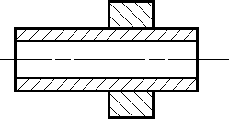
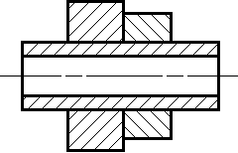
Cross Hatching an assembly with multiple parts
When hatching assembled parts, the direction of the hatching should be reversed on adjacent parts. If more than two parts are adjacent, then the hatching should be staggered or the spacing changed to emphasise the fact that these parts are separate.

Slide 9
Parts that are not Cross Hatched
To improve clarity in a sectioned drawing , standard parts will not be cross hatched even though the cutting plane passes them.
These standard parts include:
Solid shafts
Bolts and nuts
Washers
Ribs and spokes of wheels
Webs.

Slide 10
Shaft or axle
Nut
Web

Slide 12
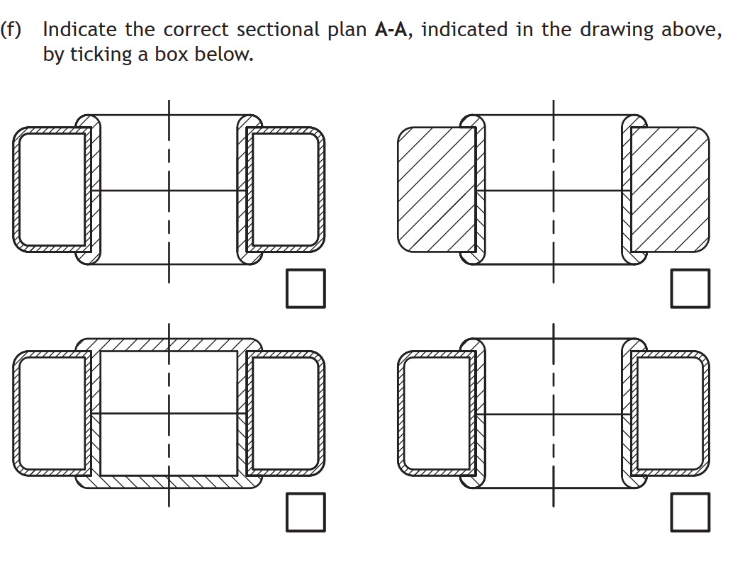
Hatch in same direction of inner ring.
Shows the sides as solid.
Does not show the hole.

Slide 13
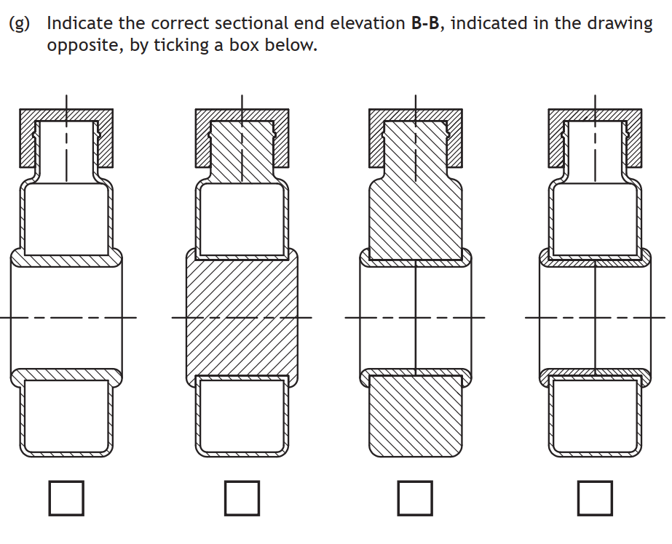
Centre component not separate.
Main component is solid
Hole is solid here.

Slide 14
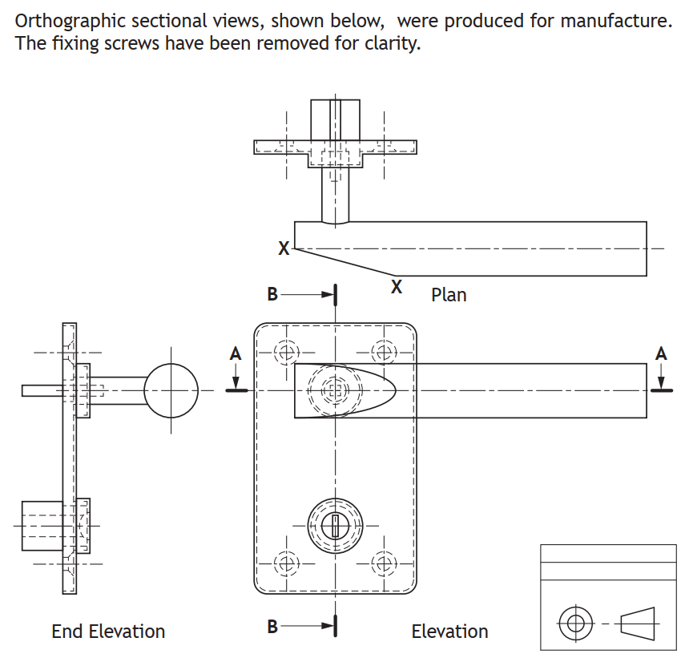

Slide 15
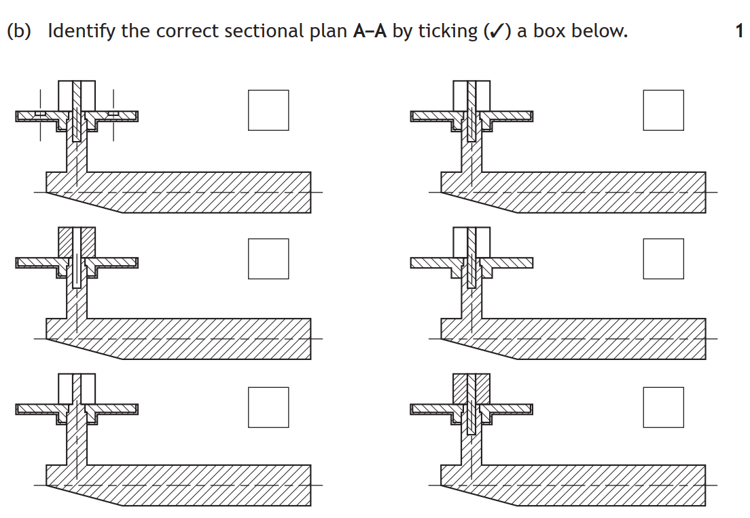
Section does not go through the screw holes
Door insert is hatched. Pin is not hatched.
No thickness to plate
Shows handle and pin as the same piece.
Door insert is hatched as well as pin.

Slide 16
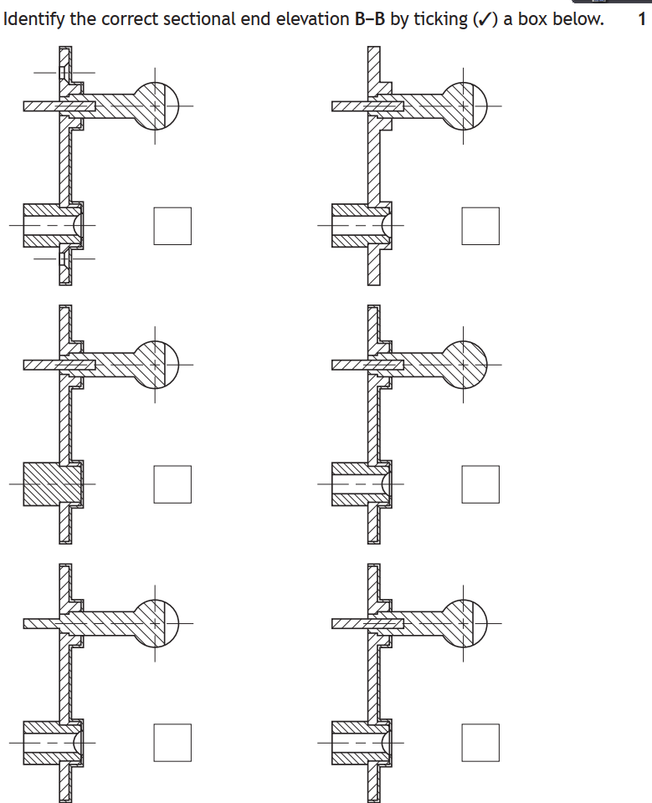
Shows a screw hole
No thickness to plate
Doesn’t account for slope in handle
Door insert is solid
Handle an pin are one part

